Slide 1

The Integrated Resource Team
An Approach to Building Success for Individuals with Barriers to Employment.

Slide 2


Meet Your Facilitators
Nikki Powis
National Disability Institute
(907) 957-4702
npowis@ndi-inc.org
Sarah Loizeaux
National Disability Institute
(978) 621-4569
sloizeaux@ndi-inc.org
Notes:
Introductions

Slide 3
Objectives
Understand the Integrated Resource Team (IRT) strategy and how it can be applied
Understand how the IRT Strategy fits into the Delaware Workforce System priorities
Recognize benefits of the IRT strategy for customer service
Identify resources that will support collaborative teams in using the IRT strategy through the Community Academy
Learn how to structure and conduct IRT meetings

Slide 4
Connecting the IRT to:
1: Delaware Workforce System Priorities
2: WIOA

Slide 5
Delaware Statewide Service Alignment Goals
    Adult Career Pathways
    Frontline Services
    Business Engagement
    Case Management
    Process Re-design

Slide 6
WIOA and the IRT
WIOA …
  Calls for streamlining of core programs, including the development of a Combined or Unified State Plan and cross-system/program common measures; and
  Calls for focusing services on targeted populations that have barriers to employment and for providing more wraparound services.
The IRT …
  Streamlines services through a cross-agency team approach; and
  Offers a tangible model for providing wraparound services based on the individual need of the job seeker to help the job seeker meet their employment goal (WIOA Common Performance).

Slide 7
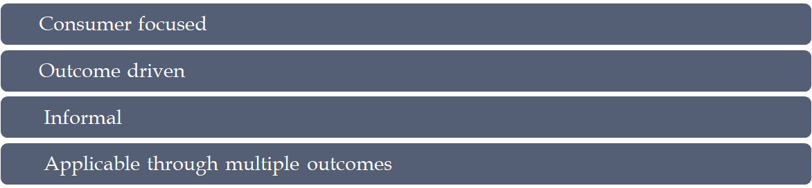

WIOA and the IRT (continued)
The IRT has many qualities that may make it an important and effective strategy for emerging WIOA service delivery models as it is a method of coordinating resources that is…

Slide 8
Conceptualizing the IRT

Slide 9

The Silo Effect

Slide 10
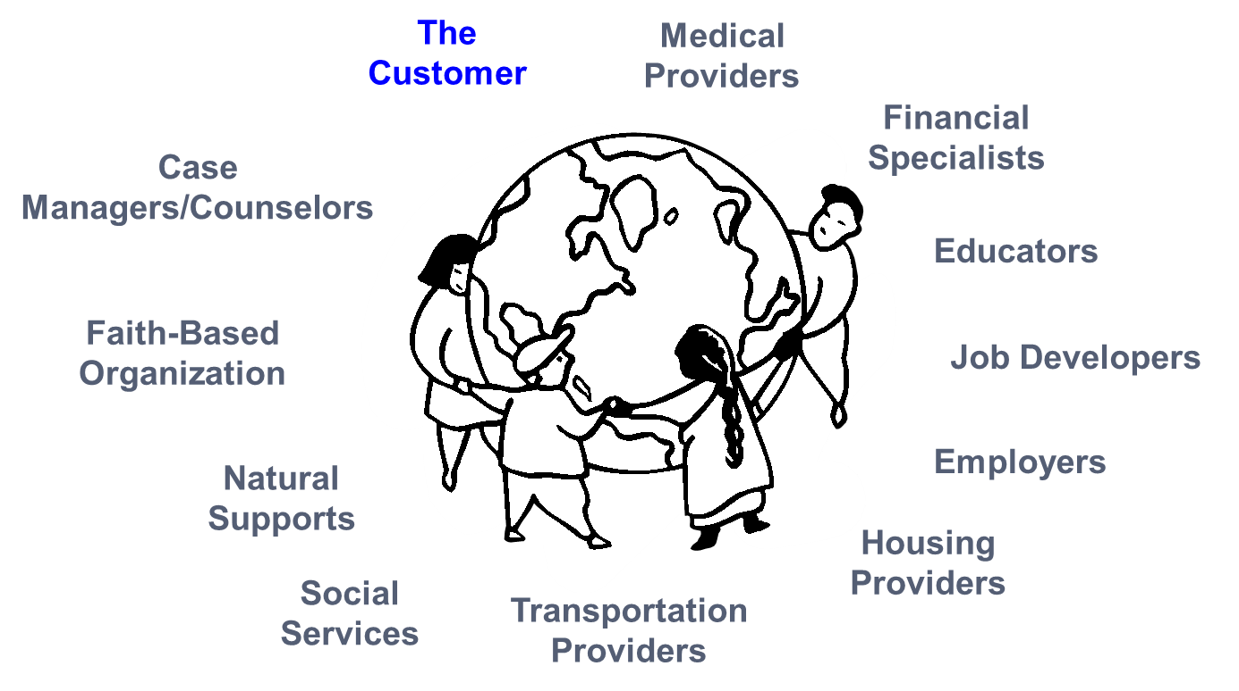
The IRT Connection
The Customer
Medical Providers
Financial Specialists
Educators
Job Developers
Employers
Housing Providers
Transportation Providers
Social Services
Natural Supports
Faith-Based Organization
Case Managers/Counselors

Slide 11
Historical Background
Born from the Disability Program Navigator (DPN) Initiative and its successor, the Disability Employment Initiative (DEI)
Developed in response to the challenge of providing services across multiple systems based on the needs of an individual consumer
Identified that customers often did not access all needed resources or received duplicative
Recognized the need to address resource gaps based on an individual’s needs
Proved that through the IRT individual and systems level change could occur
Notes:
Born from the Disability Program Navigator (DPN) Initiative and its successor, the Disability Employment Initiative (DEI), the Integrated Resource Team (IRT) model was developed in response to the challenge of developing a coordinated approach to service delivery across multiple services systems based on the needs of an individual consumer.

Slide 12
Defining the IRT

Slide 13
What is an IRT?
Initiated on behalf of a customer to address that individual’s specific needs
Brings together a team of diverse service providers to strategize how services can be coordinated to reach and maintain an employment goal
Is an informal agreement between a customer and the systems providing services
The customer and the team of service providers come together to establish three main components:
    Customer-identified, mutually agreed upon, employment goal
    Lines of Communication
    Sequence of Services.
Notes:
An IRT is initiated on behalf of an individual customer who is experiencing multiple challenges to employment in order to address that individual’s specific needs.
It brings together a team of diverse service providers, including community and partner agencies and other core partners, who work together with the individual to strategize how services can be coordinated to reach and maintain an employment goal.
The customer and the team of service providers come together to establish three main components:
Customer-identified, mutually agreed upon, employment goal
Lines of Communication
Sequence of Services.

Slide 14
Goals of the IRT
  Enhance cross-agency, cross-system collaboration and communication
  Collaboration makes everyone’s job easier
  Promotes relationship building
  Allows the members to coordinate resources
  Customer driven approach - members of the team are based on the customer’s unique needs
  Promotes shared accountability
  Share resources to address the needs of more people
  Shared outcomes across systems
Notes:
Enhance cross-agency, cross-system collaboration and communication to better leverage available resources in a seamless way for an individual customer.
Help partner agencies see the benefit of collaboration, which, in turn, makes everyone’s job easier.
Promotes informal collaboration and relationship building by bringing together public and private sector representatives from the community to work together to assist an individual in meeting their employment goal.
Allows the members to coordinate resources, both financial and
non-financial, at a customer level around a shared employment goal.
The IRT is a customer driven approach where the customer participates in the IRT as an integral member of the team. Members of the team are based on the customer’s unique needs.
The IRT, through its collaborative and coordinated approach to service delivery with its shared customers, shared resources and shared outcomes, creates a mechanism for shared accountability.
Additionally, by sharing customers, agencies can share resources and ultimately are able to address the needs of more people.

Slide 15
What an IRT IS and What it IS NOT …
  An IRT is an approach used for an INDIVIDUAL customer.
      An IRT is NOT an interagency committee consisting of various disability/community agencies that focus on systems collaboration.
  The main purpose of an IRT is EMPLOYMENT.
      The main purpose of an IRT is NOT resource mapping or to assist an individual to learn about various agency resources.

Slide 16
Who Participates in an IRT?
An IRT may consist of members from a wide variety of community programs and service providers, including the following:
  The Workforce system
  Behavioral Health
  Vocational Rehabilitation
  Community Work Incentives Coordinator
  Employment Specialists
  Housing Provider
  School or Post Secondary Education
  Employer
  Correctional system - probation
  TANF
  Faith Based organizations
  Social Services
  Transportation services
  Apprenticeship sponsors
  Veterans Services
  Advocates/Friends of Job Seeker
  Others?

Slide 17
Developing Partnerships through the Community Academy

Slide 18
The Community Academy – Strategy to Get to Know Your Partners
Brings together a wide range of community partners – traditional and non-traditional
Promotes knowledge translation of all programs and resources
Allows for “same page” understanding of the IRT and enhances “by-in”
Produces “out of the box” thinking
Builds relationships
Develops cross agency team collaboration
Allows for brain storming of real customer issues
Enhances effectiveness of future work
Enables understanding of one another's possibilities and limitations

Slide 19
Coordinating an IRT
Notes:
Turn over to Sarah

Slide 20
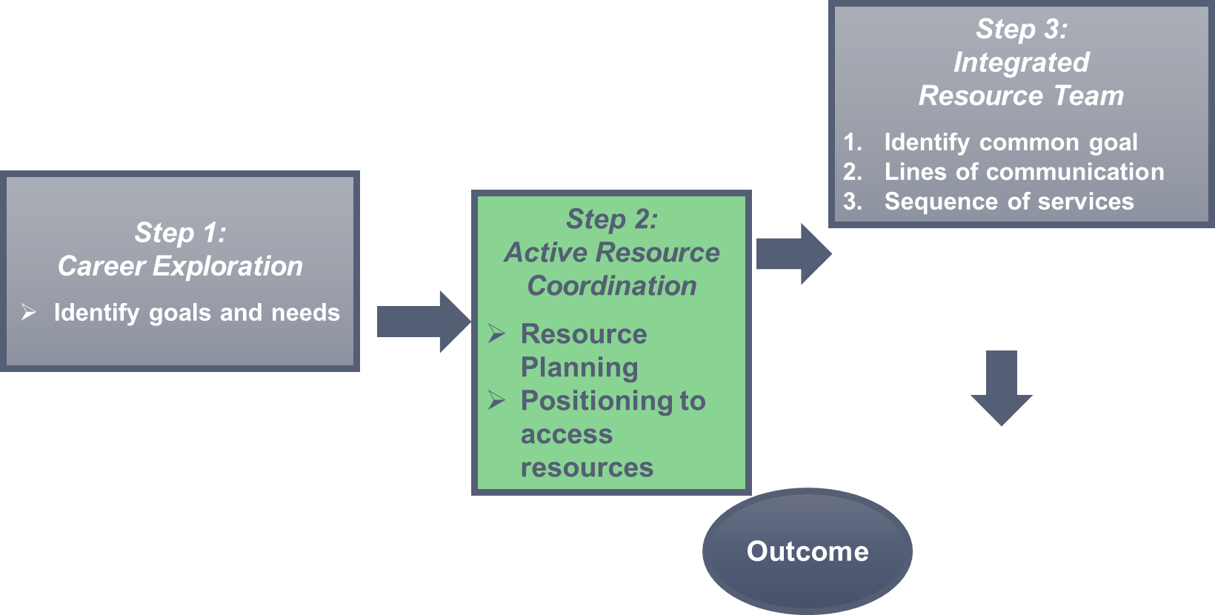

IRT Flow of Services

Slide 21
Step 1: Career Exploration and Need
As was noted in the previous section, the purpose of an IRT is to help the consumer attain their specific employment goal
Career Exploration serves as the first step in developing an IRT. The career exploration should result in a proposed employment goal that is:
Self-determined
Strength-based
Concrete enough to build a plan around
Meets the required outcomes of the systems accessed.

Slide 22
Step 1: Career Exploration and Need (continued)
Once the employment goal has been identified, consider the following:
Employment Goal
    Are there resources and/or expertise beyond what is available from your own system that are critical to your customer’s success in attaining the proposed employment goal?
The Customer
    What other systems is your customer currently accessing?
    Are there other systems that can help them attain and retain the proposed employment goal?

Slide 23
Step 2: Active Resource Coordination
  Active Resource Coordination (ARC) is the process of identifying needed resources and appropriate and prioritized action steps to address specific, targeted barriers to employment experienced by an individual customer.
  ARC is likely something you are already doing during the process of intake and plan development. Compared with the current service delivery model, this may just be an enhanced and more intentional step under the IRT approach.
  ARC is more than just a referral to multiple service providers.
  ARC is the process of helping the customer create a goal-specific (hint: employment goal) resource plan.

Slide 24
Step 2: ARC (continued)
  ARC is directly assisting a customer to convene and negotiate with multiple service providers to create an employment plan that accesses needed resources from multiple systems. Considerations when determining if your agency does active resource coordination include the following:
  Are referrals given before or after the development of an employment goal?
  Is communication between service providers solely the responsibility of the customer?
  Active Resource Coordination always takes place PRIOR to an Integrated Resource Team (IRT) being put in place, although active resource coordination may take place without resulting in an IRT.
  So you can have ARC without an IRT, but you CANNOT have an IRT without first having done some Active Resource Coordination!

Slide 25
Step 2: ARC vs. Simple Referral
  Active Resource Coordination is more than simple referral. As noted on the previous slide, it includes helping the customer to engage and approach partners around the potential for partnering with your agency.
  Many agencies will provide information and referral, but the customer may not understand the relevance of a referral or the steps that need to be taken. Active resource coordination helps the customer to identify, engage and coordinate resources around their needs relevant to achieving their employment goal.

Slide 26
Step 3: Building the IRT
THREE ELEMENTS OF EVERY IRT MEETING
THREE ELEMENTS OF EVERY IRT MEETING
The Individual
    Multiple needs/barriers
    Lack of coordination
    “Stuck”
The Team
    Led by the job seeker
    Professional support is only a facilitator
    Expertise and partnering is the key
The Plan
    Not about the solution; about the puzzle
    Evolves
    Not tied to funding

Slide 27
Building the Team
The Customer
Medical Providers
Financial Specialists
Educators
Job Developers
Employers
Housing Providers
Transportation Providers
Social Services
Natural Supports
Faith-Based Organization
Case Managers/Counselors

Slide 28
Step 3: Who Should Be at the Table?
The Employment Goal
  What resources beyond those available in your system are critical to your customer’s success in attaining their employment goal?
The Customer
  What system is your customer currently accessing?
  What services might your customer be eligible for that are relevant in the context of attaining their stated employment goal?

Slide 29
Step 3: Approaching Partners
Before approaching partners, the customer should be engaged by your system and positioned to access your system’s resources.
For example …
  Customer should be eligible or presumed eligible for your system’s services.
  Customer should have determined an employment goal that allows for the application of your system’s resources.
  Customer should be consulted and agree to all contacts, and have a clear understanding of the IRT approach and its benefits.

Slide 30
Step 3: Building the IRT - Partnerships
Connect to partners based on individuals needs and service gaps
  Connect to services your customer is already involved in
  Determine what other services they need to connect to and invite
If the customer needs to apply for services prior to attendance at the IRT, assist with the process
  Ask questions concerning the specific services that are being delivered.
  Emphasize the benefits of partnering with your program .
  Try to uncover areas where you or the partner have some flexibility within the established plans.

Slide 31
Step 3: Building the IRT -- Convening the meeting
Once the customer is determined eligible by another service provider, and these service providers are agreeable to partnering, discuss with your customer their role as the driving member of the Integrated Resource Team.
After establishing the customer’s role, a face-to-face meeting should be convened -- whenever possible -- with the partners and the customer. If a face-to-face meeting is not possible, virtual meetings are adequate.
The purpose of the meeting is to reach consensus around the following three key parameters:
    A common employment goal
    Lines of Communication
    A Sequence of Services

Slide 32
Considerations and Plan Negotiation
Notes:
Turn over to Sarah

Slide 33
A Quick Review:
Active Resource Coordination is the process in which you help customers identify resources, that are beyond what your own program can provide, and help to engage those resources around a mutually agreed upon employment goal.
Following Active Resource Coordination, an IRT meeting is convened with the customer and partner agencies in which (led by the customer) the customer and agencies come to consensus around three key parameters:
    Employment Goal
    Lines of Communication
    Sequence of Services
Customers and Partners agree to roles and services consistent with their own agencies allowances and plans are documented and moved forward.
Notes:
Back to Nikki

Slide 34
IRT Considerations
Based on your customer’s work goal and listed challenges, determine the following:
  What types of people, supports, resources does this individual need to reach their goal?
  With this information, who should participate in this individual’s IRT?
  Which agencies/individuals would contribute to the success of this individual?
  Who or what natural or other supports should be at the table?
  Who will be the most productive advocate or mentor for this individual to assist with attaining their goals?

Slide 35
IRT Considerations (continued)
Set up your IRT for success and sustainability
  Which agency would be the best fit to provide the leadership/coordination for the IRT?
  What role will each member of the team play?
  Who is responsible for what and when?
  How and when will the team communicate with the customer? With one another?
  Do you have a plan for supporting crises or roadblocks?
  Do you have equal resource sharing (time and financial), and do you have full buy-in from everyone?
  Does the individual have responsibility and buy-in?
  Who will ensure forward momentum?
  Do you have a plan for continuation beyond program exit?

Slide 36
Recapping the Benefits of the IRT

Slide 37
The Benefits of an IRT – Win-Win
(Slide 1 of 3)
The IRT approach is individualized and promotes active involvement and accountability of all team members.
IRT members and services are dynamic, providing flexible and timely services and supports that are adjusted in response to the changing needs, preferences or life situations of the individual as they move through the employment process.
The IRT is a “Team Approach,” ensuring a holistic response, providing a full complement of needed services for the individual.
The IRT leverages existing resources to improve coordination and avoid duplication of services.
Active Resource Coordination can provide the vehicle for agencies to come together and provide stabilization services to prepare an individual to develop an employment goal prior to participating in the full IRT services.
The “Teamwork” established within the IRT alleviates a heavy load on any one person or agency.

Slide 38
The Benefits of an IRT – Win-Win
(Slide 2 of 3)
The IRT can designate a member to maintain documentation of services and progress that can be replicated through copy/paste and entered into each agency’s separate MIS systems, thereby cutting down on documentation burden. Assessment documents can be shared so all agencies get the same information as needed.
The IRT promotes accountability and follow-through for both individual and service providers.
The IRT can provide a single point of contact for the individual with lines of communication being established as a mechanism to keep all members informed.
The IRT can happen anywhere providing ease of access for the individual to their service team.

Slide 39
The Benefits of an IRT –Win-Win
(Slide 3 of 3)
The IRT can establish complimentary services and increase practitioner’s knowledge of other service delivery options. Team members can establish a common mission that respects individual agency’s criteria for services and allows each agency to contribute their strength to create a whole of the parts.
The IRT is empowering for the individuals as they see how many people they have supporting and encouraging them to achieve their goals.
Lines of communication are established to include a common understanding of individual agency terms and definitions.
The IRT provides a mechanism for sharing costs, resources and can establish common goals for the individual that can be replicated on each agency’s individualized plan.
The IRT builds relationships between agency staff and the individuals they serve.

Slide 40

The IRT Positive Results

Slide 41
The Emerging IRT Pilot in Delaware
Led by Delaware Division for the Visually Impaired (DVI)
Pilot location identified
Training for staff completed
Specific counselors identified
DVI is working on the internal structure and developing an organized list of available resources/service providers currently
For more information contact:
  Jamie Towns
  Phone (302) 255-9822
  jamie.towns@delaware.gov

Slide 42
Resources
Success Stories in Utilizing an Integrated Resource Team
February 2018 (Iowa)
  https://www.youtube.com/watch?v=CYuWjYKgZdI
Integrated Resource Team Portland Oregon
  https://vimeo.com/260033830
Workforce Innovation Technical Assistance Center (WINTAC)
  http://www.wintac.org
  Archived training on IRT – Site registration required
    http://lms.wintac.org/course/view.php?id=68

Slide 43

Questions

